Slide 1
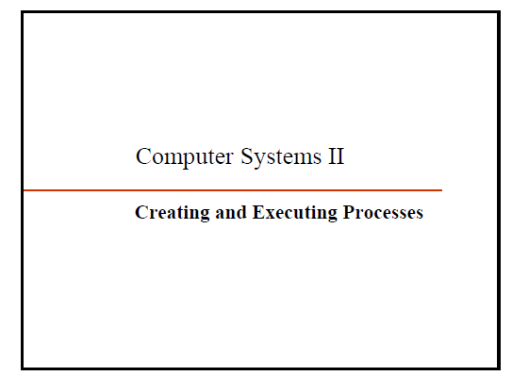

Slide 2
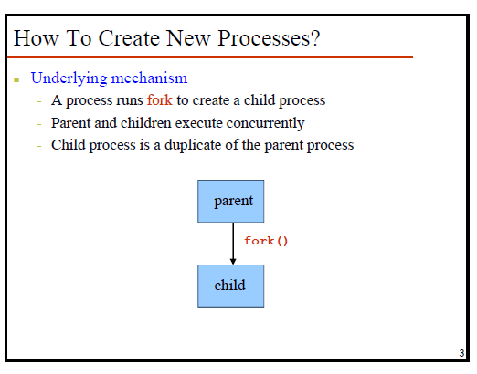

Slide 3
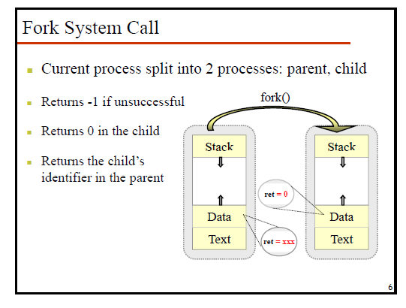

Slide 4
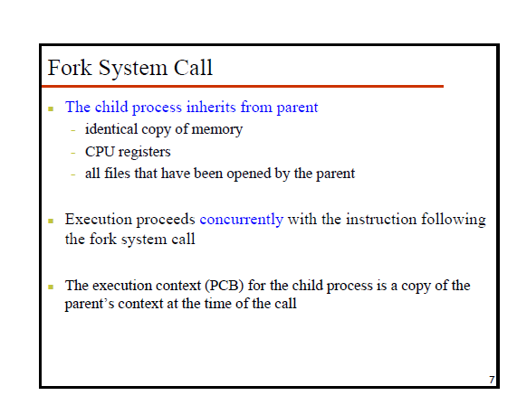

Slide 5
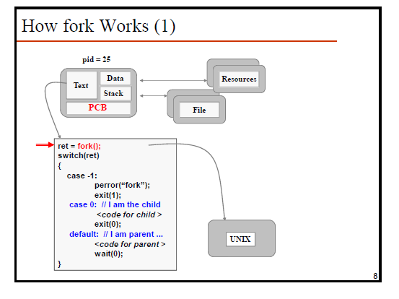

Slide 6
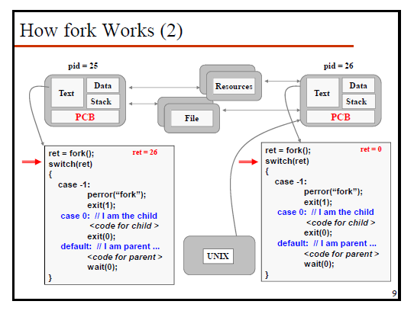

Slide 7
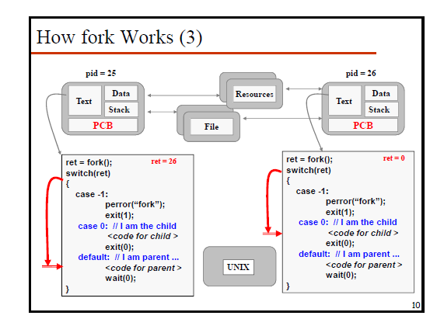

Slide 8
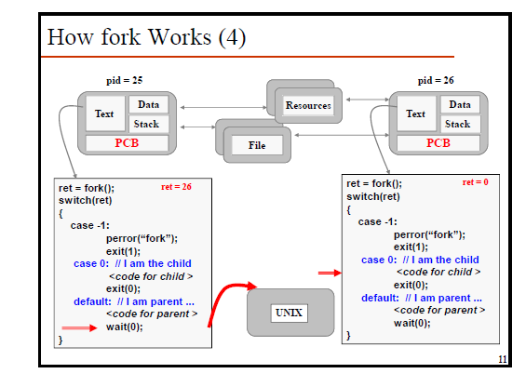

Slide 9
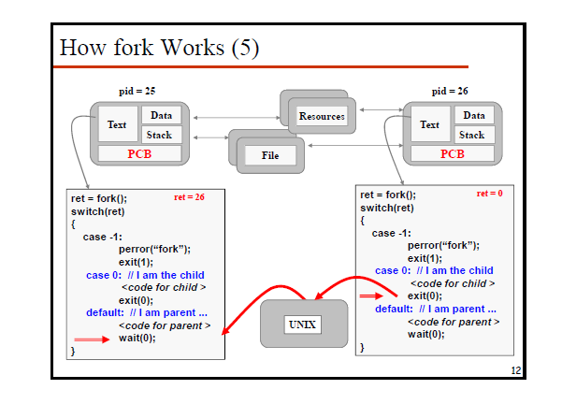

Slide 10
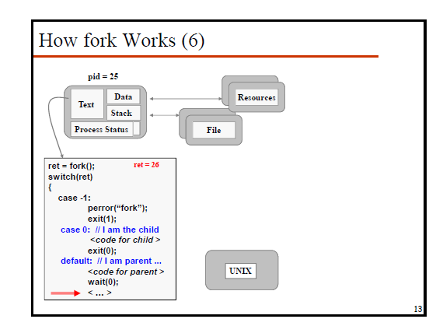

Slide 11
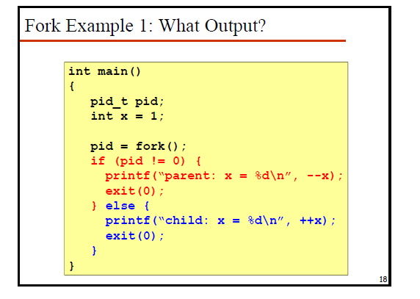

Slide 12
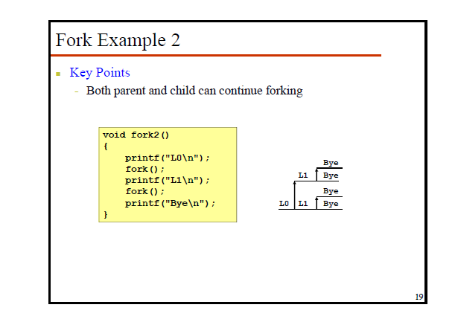

Slide 13
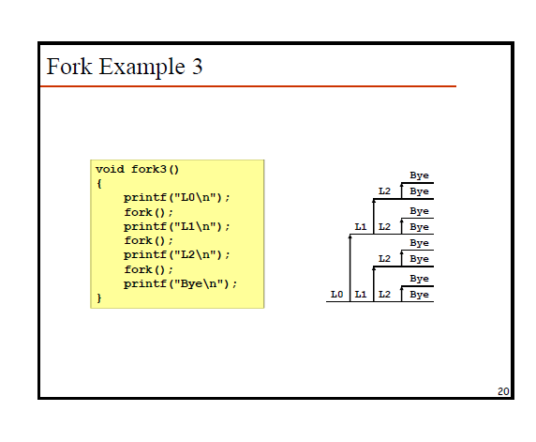

Slide 14
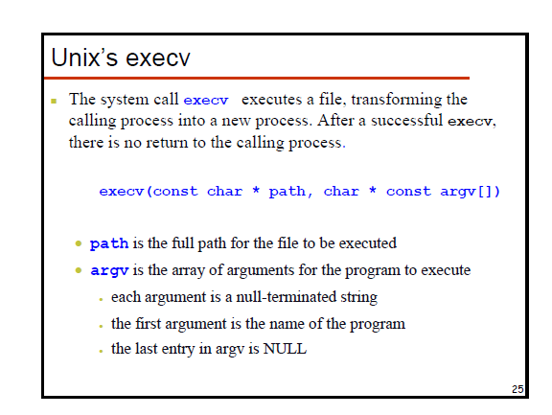

Slide 15
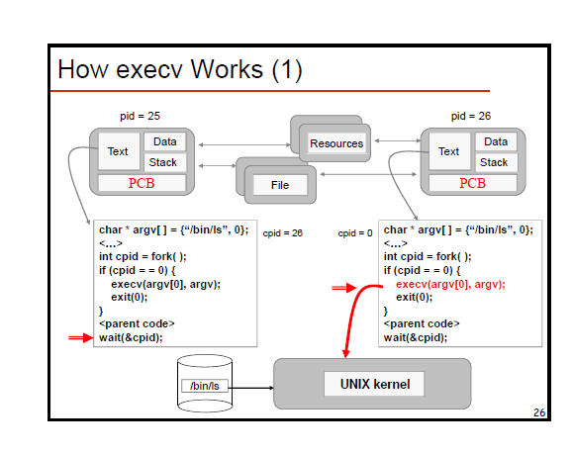

Slide 16
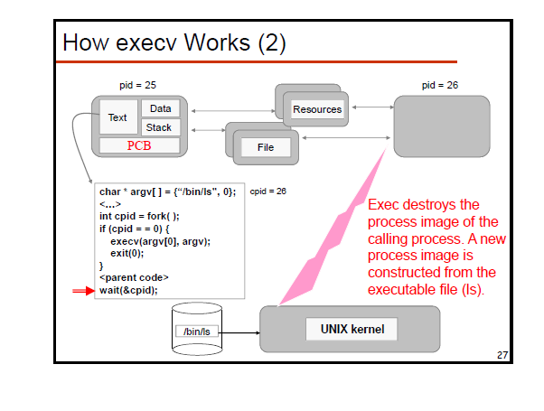

Slide 17
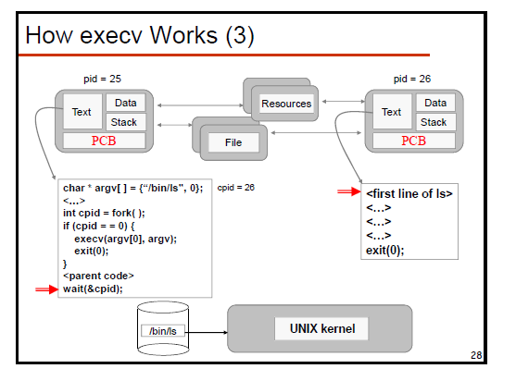


Slide 18
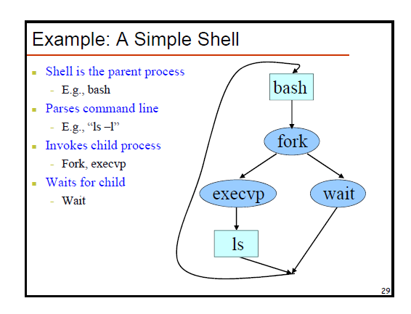

Slide 19
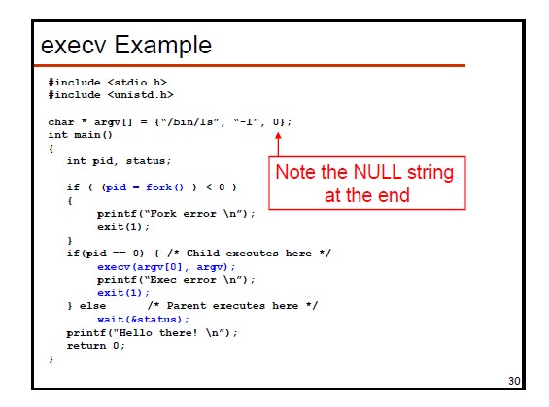

Slide 20
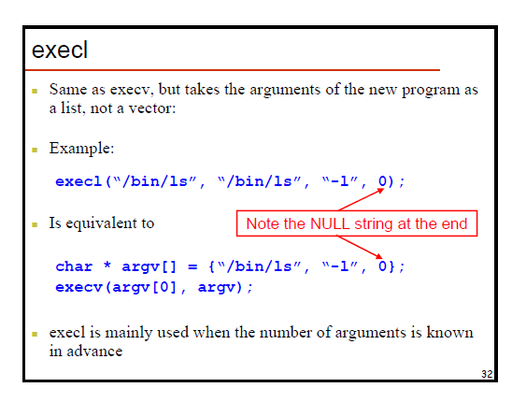

Slide 21
Simple program to fork a new process
#include <stdio.h>
main (int argc, char *argv[])
{ int pid ;
char *args[2] ;
printf("Ready to FORK\n") ;
pid = fork() ;
if (pid ==0)
printf("I AM THE CHILD!!\n") ;
else
printf("I AM THE PARENT!!!\n") ;
}

Slide 22
Simple program to show how children get out of control if not monitored by the parent.
#include <stdio.h>
main (int argc, char *argv[])
{ int pid ;
char *args[2] ;
printf("Ready to FORK\n") ;
pid = fork() ;
if (pid ==0)
{ printf("I AM THE CHILD!!\n") ;
args[0] = "./a.out" ;
args[1] = NULL ;
execv("./a.out", args) ;
printf("OPPSSSS\n") ;
}
else
printf("I AM THE PARENT!!!\n") ;
//wait(NULL) ;
}

